Slide 1
DeepRoad Dev Roadmap
June 2021
Philippe Heitzmann

Slide 2
Option 1: Apply to Accelerator Program
Accelerators Overview
Accelerators operate on the goal of making cohort startups reach scale up stage so they can be ready for a seed or series A funding from VCs and provide some level of pre-seed or seed investment for each startup within their cohort in return for an equity stake in the company, usually 7% — 10% equity for around $100,000 initial investment, in order to do so. These are limited period programs where a group of companies are brought in by the accelerator and in a high pace program are taught years of learning in weeks/months.
Accelerator Landscape & Deadlines
Accelerator | Type | Deadlines
Techstars Austin | Tech | October 6th 2021 to apply; Jan 10th 2022 accelerator starts; March 21st, 2022 demo day
Techstars Boulder | Tech | October 6th 2021 to apply; Jan 24th 2022 accelerator starts; April 21st 2022 demo day
Techstars Seattle | Tech | October 6th 2021 to apply; Jan 24th 2022 accelerator starts; April 21st 2022 demo day
TechStars Anywhere | Tech | October 6th 2021 to apply; Jan 24th 2022 accelerator starts; April 21st 2022 demo day
Y Combinator | Tech | Winter 2022 application round most likely opening sometime September; can also typically apply year round, though there are typically two big rounds every year. Relocate to San Francisco if selected. Last application deadline closed March 2021 but can always apply late
Entrepreneurs Roundtable Association | Tech | Two applications rounds every tear typically in April / May. NYC based-program lasting four-month with $100,000 investment. Last application round closed April 2021 and TBD on next 2021 round.
Acceleriprise | Tech | Four-month program with $100,000 equity investment. Last deadline to apply June/July 2021
500 Startups | Tech | Offers $100,000-$150,000 funding with main accelerator programs happening in San Francisco & Miami

Slide 3
Option 2: Startup Competitions
Startup Competitions Overview
Startup pitch competitions allowing founders to compete for funding, either in the form of cash awards with equity stake strings or straight cash awards with no such strings attached, and to gain media & investor exposure through the process of on-stage pitch and product demo at a conference.
Startup Competitions Landscape & Deadlines
Accelerator | Deadline & Description
TechCrunch Startup Battlefield | Most likely September 2022 with applications opening May 2022. TechCrunch’s Startup Battlefield is the world’s preeminent startup competition. Startup Battlefield features 15-30 top early stage startups pitching top judges in front of a vast live audience, present in person and online. Teams go through an intensive mini-accelerator for 8 weeks before each event, honing their business models and pitches. Startups pitch on stage for six minutes, followed by an intense question and answer session with top investors, entrepreneurs, and technologists. All cash prize with no equity stake strings attached
Startup World Cup 2021 | Compete in Regional Qualifiers typically happening year-round in US depending on region & pitch at national-level Grand Finale typically happening November / December each year if selected. $1,000,000 winning prize & opportunities to network with top investors & industry mentors
Get in the Ring | Can go through selection rounds in a certain city or online; chance to win prizes and network with investors & corporates and potentially forge relationships with large companies already operating in those spaces. More European-centric but some focus on North America region
TechStars Anywhere | October 6th 2021 to apply; Jan 24th 2022 accelerator starts; April 21st 2022 demo day
Alconic Awards | Purely focused on media recognition as no monetary prizes available. More focused on AI. New York AI Summit scheduled Dec 8th 2021
HATCH Pitch | Funding opportunities available. Typically happens once annually in May / June

Slide 4
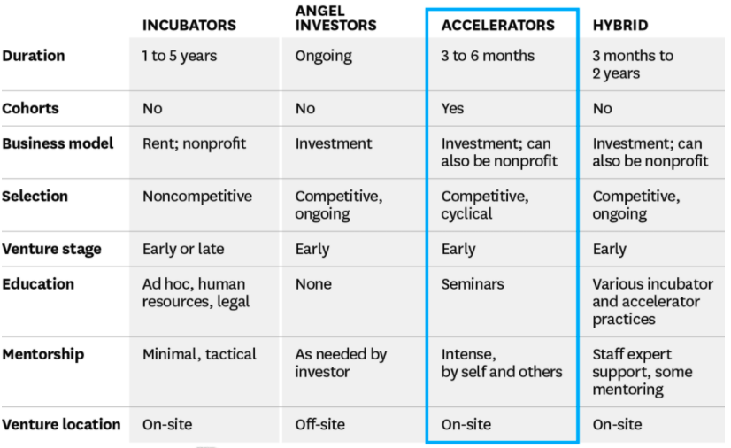
Option 3: Incubators / Angel Investors
Incubators / Angel Investors Overview

Slide 5
What is DeepRoad?
Y Combinator Application Questions pt.1
IDEA
Why did you pick this idea to work on? Do you have domain expertise in this area? How do you know people need what you're making?
Philippe has 1 ½ years of experience in data science with three months working full-time as a data scientist at J.P. Morgan
What's new about what you're making? What substitutes do people resort to because it doesn't exist yet (or they don't know about it)?
Human visual inspections accounts for majority of road pavement distress inspections today. Drawbacks include high financial and time expense, human error in pavement distress classifications & poor standardization & uniformity of inspection classifications between localities making resource allocation decisions at higher levels of government administration more difficult.
Who are your competitors, and who might become competitors? Who do you fear most?
TÜV SÜD, MISTRAS, Ricoh, DM Roads, City Reporter
What do you understand about your business that other companies in it just don't get?
Few focusing on deep learning-enabled monitoring solutions and more focused on visual, radar or Lidar-based inspection systems
How do or will you make money? How much could you make?(We realize you can't know precisely, but give your best estimate.)
Monetization options:
Price at fixed rate per mile of road inspection
Price on quoted ad hoc basis based on estimated complexity of mapping & associated GIS map of road distress classification locations
How will you get users? If your idea is the type that faces a chicken-and-egg problem in the sense that it won't be attractive to users till it has a lot of users (e.g. a marketplace, a dating site, an ad network), how will you overcome that?
Primary client base will consist of municipal, county, state and federal government actors. Operators of parking lots, port terminals & large universities & other school systems may account for other non-trivial share of client base
1

Slide 6
What is DeepRoad?
Y Combinator Application Questions pt.2
Company
Describe what your company does in 50 characters or less.
Making road & pavement condition monitoring & maintenance more accurate & affordable
What is your company going to make? Please describe your product and what it does or will do. DeepRoad deploys vehicle-mounted camera systems that can capture & automatically classify road & pavement distresses through algorithmic computer vision analysis. DeepRoad is much more economical than the current state of human visual road & pavement inspections or other radar-based systems.
PROGRESS
How far along are you?
How long have each of you been working on this? How much of that has been full-time? Please explain.
1

Slide 7
Market Size & Other Considerations
$2.1-$4.2bn estimated US market size
In 2014, a total of $416 billion was spent on highway and water infrastructure, $320 billion of which came from state and local government, with $112 billion for capital projects and $207 billion for operation and maintenance.
Of the $416 billion total, $165 billion was for highways alone, which includes national, state and local roads, bridges and tunnels
Conservatively assuming 1-2% of this $207bn 2014 total is earmarked for road pavement distress inspection entails $2.1bn - $4.2bn estimated market size in the US alone
Capturing 10-20% of the US govt road inspection market after 7 years would entail a $200mm - $400mm gross revenue opportunity annually once business reaches mid maturity
1
1. J. A. Epps and M. Ardila-Coulson, “Summary of shrp research and
economic benefits of pavement maintenance,” Federal Highway Administration,
Tech. Rep., 1997.
2. N. H. T. S. Administration, “National motor vehicle crash causation survey: Report to congress,” National Highway Traffic Safety Administration Technical Report DOT HS, vol. 811, p. 059, 2008.
Damage Detection using Ensemble Learning

Slide 8

Back of Envelope Business Valuation Math
$100mm valuation conservatively for US market alone
Back of envelope DCF math:
Assuming conservatively 20% gross margins after COGS, SG&A & CAPEX costs
7 years to capture 10-20% of road inspection market and assuming 15% middle point
Year 1 operating profit of $10mm (it may take up to several years to reach year 1)
30% annual growth rate entailing Year 7 operating profit of $60mm
25% WACC
~= $100mm valuation conservatively today with potential for greater appreciation beyond this horizon based on business growth in the US and internationally
GOAL:
1
1. J. A. Epps and M. Ardila-Coulson, “Summary of shrp research and
economic benefits of pavement maintenance,” Federal Highway Administration,
Tech. Rep., 1997.
2. N. H. T. S. Administration, “National motor vehicle crash causation survey: Report to congress,” National Highway Traffic Safety Administration Technical Report DOT HS, vol. 811, p. 059, 2008.
Damage Detection using Ensemble Learning

Slide 9
Next steps
3 month timeline:
Philippe & Peter finish select parts of Andrew Ng Deep Learning Specialization course, 1-2 weeks
Publish paper on performance of models trained on available IEEE data on Japan, India, Czech Republic
Think about bringing on other technical co-founder that can lead a lot more of deep learning side
Create MVP deploying trained computer vision model to smartphone camera, 1-3months stealth mode
Build, train & deploy deep learning models
Explore whether better to buy or rent GPU hardware
Bring on more data
Test different model architectures
Build UI for employees and contractors to interact live with the app and design software to deliver final package of GIS model
6 month timeline
Launch private beta inviting select users to gather preliminary feedback
Iterate further on product based on user feedback
9 month timeline
Apply to accelerator programs with MVP in hand in order receive funding & gain investor attention
Explore patentability of (i) method of vehicular screen capture and subsequent computer vision analysis of footage & (ii) software interface for distress analysis
1

Slide 10
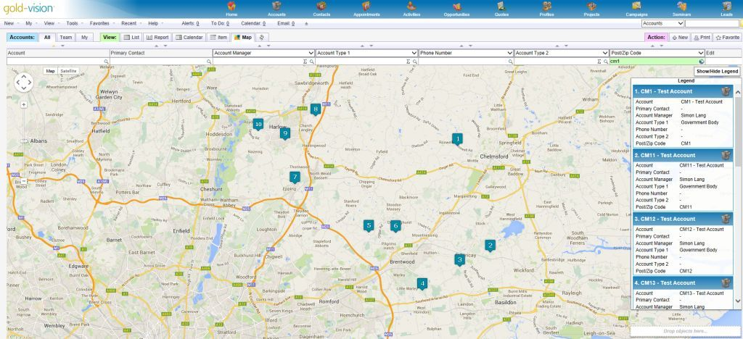
UPLOAD IMAGES
Supported filetypes: zip, tar, gz
Road Distress Dashboard
Map View
Road Distress | # Detected
Reflective Crack | 18
Transverse Crack | 25
Block Crack | 4
Longitudinal Crack | 32
Pothole | 1
Alligator Crack | 8
Click here to download full report
1
Notes:
DESKTOP APP DESIGN

Slide 11
Current State of Road Distress Inspections
Some agencies perform pavement condition surveys using road survey vehicles equipped with many sensors to evaluate pavement conditions and deterioration. In these vehicles, laser line-scan cameras and three-dimensional (3D) cameras are generally employed to capture pavement surfaces with the best possible quality and resolution. However, such imaging equipment mounted on dedicated vehicles is expensive and is often unaffordable for local agencies with limited budgets. https://arxiv.org/abs/2011.08740
State and local maintenance departments are tasked with keeping roads in good repair. One part of this task is to monitor the degradation of road condition, which manifests itself with the presence of cracks, potholes, and other distress. Currently, this is done by: (i) inspectors who visually judge the road condition, (ii) specialized vehicles which measure the distress with cameras or laser devices, (iii) citizens who call in their observations. The first method is tedious and often inconsistent if several inspectors do the inspections. The second method does not have these problems, but it is generally expensive. Usually one stretch of road is only traversed by the specialized vehicle once every two years. This method is effective for interstates and highways, but it is not practical for the inner roads in a city. As for the third method, reports by citizens are generally only about severe problems, like large potholes on main roads. It is therefore desirable to have a low-cost system that can monitor the roads on a continuous basis with minimal human intervention. https://www.ri.cmu.edu/pub_files/2014/3/crack_detection_final.pdf
State of art discussion of visual & machine-based visual inspection of concrete infrastructure https://core.ac.uk/download/pdf/206622649.pdf z
1

